Slide 1

ADVANCED CALCULATOR
A Multi Functional Calculator Using Python And Tkinter
NextHikes IT Solutions
By Janani Sri

Slide 2
OVER REVIEW →
1. Basic Calculator → Addition, subtraction, multiplication, division and percentage.
2. Scientific Calculator → Trigonometric functions, logarithms, powers, square roots and constants.
3. Statistical Calculator → Mean, median, mode, variance, standard deviation and range.
4. Equation Solver → Solves mathematical equations using SymPy.
5. Graph Creation → Line graphs, bar graphs and pie charts.
6. BMI Calculator → Calculates BMI and classifies the result.
7. Age Calculator → Calculates completed years and total days lived.

Slide 3
Technologies and Python libraries used →
Technology | Purpose
Tkinter → | Creates the desktop application
ttk → | Creates tabs, buttons and input fields
Math → | Performs mathematical calculations
Statistics → | Performs statistical analysis
Datetime → | Calculates age
AST → | Evaluates mathematical expressions safely when restricted
Operator → | Performs arithmetic operations
SymPy → | Solves mathematical equations
NumPy → | Generates numerical data for graphs
Matplotlib → | Displays graphical visualizations

Slide 4
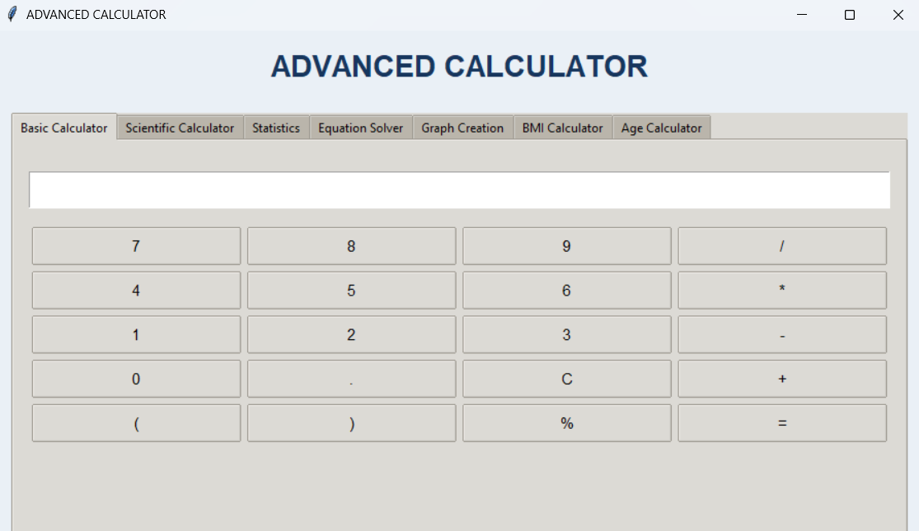
BASIC CALCULATOR →
Operation | Symbol
Addition | +
Subtraction | -
Multiplication | *
Division | /
Modulus | %
Decimal | .
Brackets | ( )
Python: Main programming language.
Tkinter: Creates the calculator interface.
ttk: Creates styled buttons and frames.
AST (Abstract Syntax Tree): Validates and evaluates mathematical expressions.
Operator: Performs arithmetic operations.

Slide 5
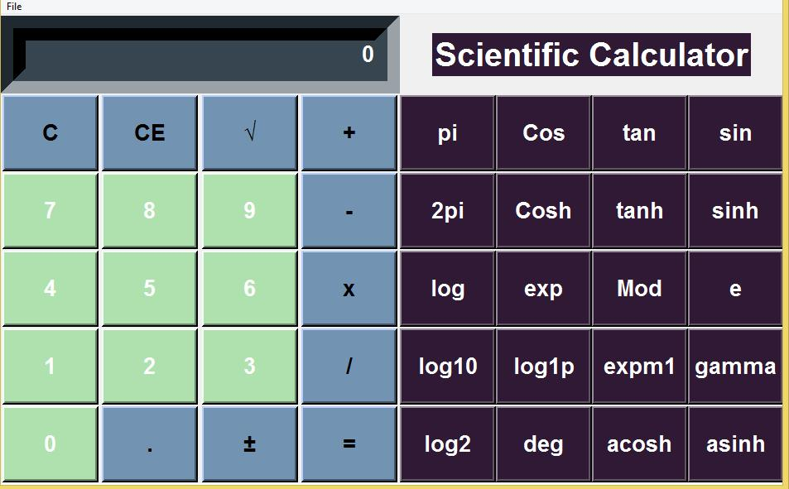
SCIENTIFIC CALCULATOR →
Function | Purpose | Example
sin() | Sine function | sin(pi/2) = 1
cos() | Cosine function | cos(0) = 1
tan() | Tangent function | tan(0) = 0
sqrt() | Square root | sqrt(144) = 12
log() | Natural logarithm | log(e) = 1
log10() | Base-10 logarithm | log10(100) = 2
exp() | Exponential function | exp(1) = 2.718...
factorial() | Factorial calculation | factorial(5) = 120
abs() | Absolute value | abs(-25) = 25
pi | Mathematical constant π | 3.14159...
e | Euler's number | 2.71828...
** | Power calculation | 2**3 = 8
% | Modulus | 10%3 = 1
Advantages of the Scientific Calculator
1.Performs advanced mathematical calculations.
2.Supports trigonometric functions.
3.Supports logarithmic and exponential calculations.
4.ncludes mathematical constants such as π and e.
5.Supports factorial and power calculations.
6.Uses AST-based expression evaluation.
7.Displays results in a separate result section.
8.Provides error handling for invalid mathematical values.

Slide 6
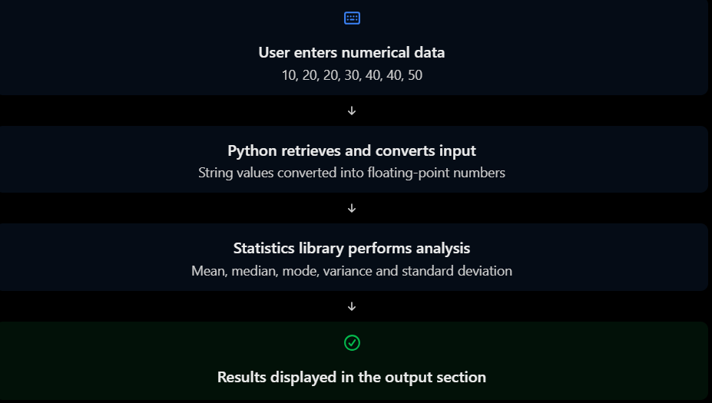
STATISTICAL CALCULATOR →
Statistical measure | Purpose
Count | Calculates the total number of observations
Sum | Calculates the total of all values
Mean | Calculates the average value
Median | Identifies the middle value
Mode | Identifies the most frequently occurring value(s)
Minimum | Finds the smallest value
Maximum | Finds the largest value
Range | Measures the difference between maximum and minimum
Sample Variance | Measures the dispersion of sample observations
Sample Standard Deviation | Measures sample variability
Population Variance | Measures dispersion of an entire population
Population Standard Deviation | Measures population variability

Slide 7
EQUATION SOLVER →
Technology | Purpose
Python | Main programming language
Tkinter | Graphical user interface
SymPy | Symbolic mathematics and equation solving
Message box | Displays error messages
SOLVES THE SINGLE VARIABLE EQUATIONS –
1.Linear equations: \(2x+5=15\)
2.Quadratic equations: \(x^2-5x+6=0\)
3.Polynomial equations: \(x^3-6x^2+11x-6=0\)
SYMPY FUNCTIONS
symbols() – Defines mathematical variables.
sympify() – Converts the entered expression into a mathematical expression.
solve() – Finds the solution of the equation.

Slide 8
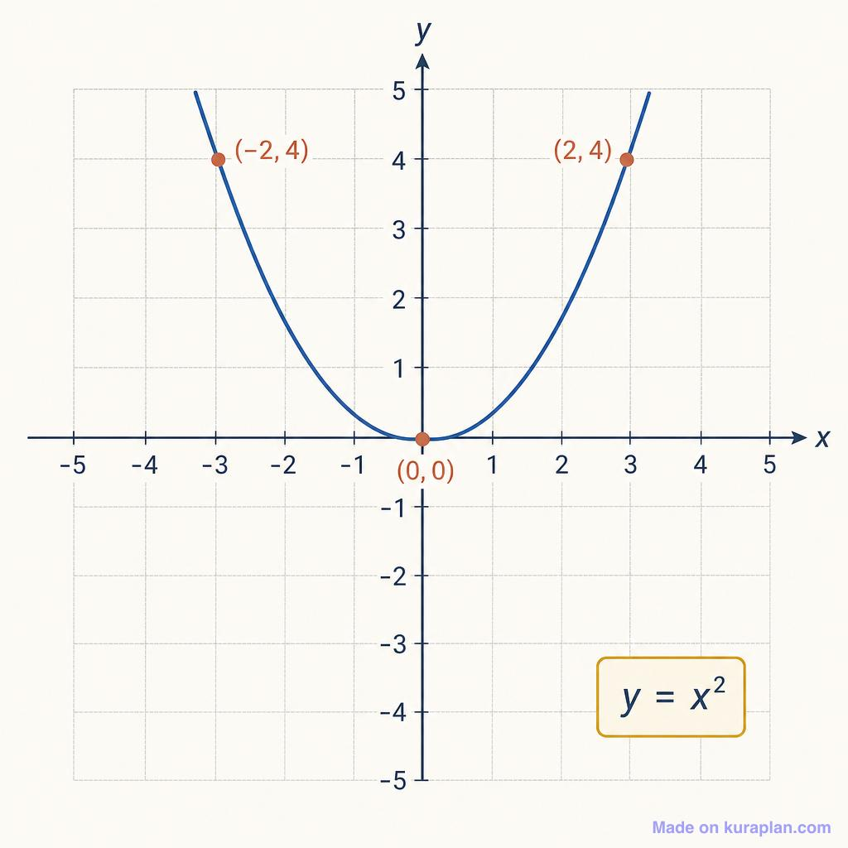
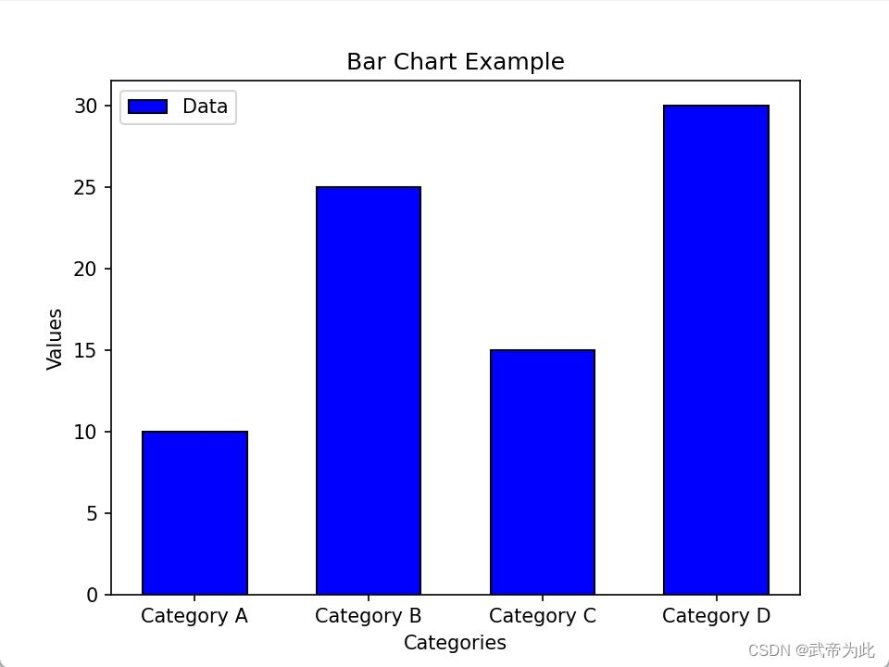
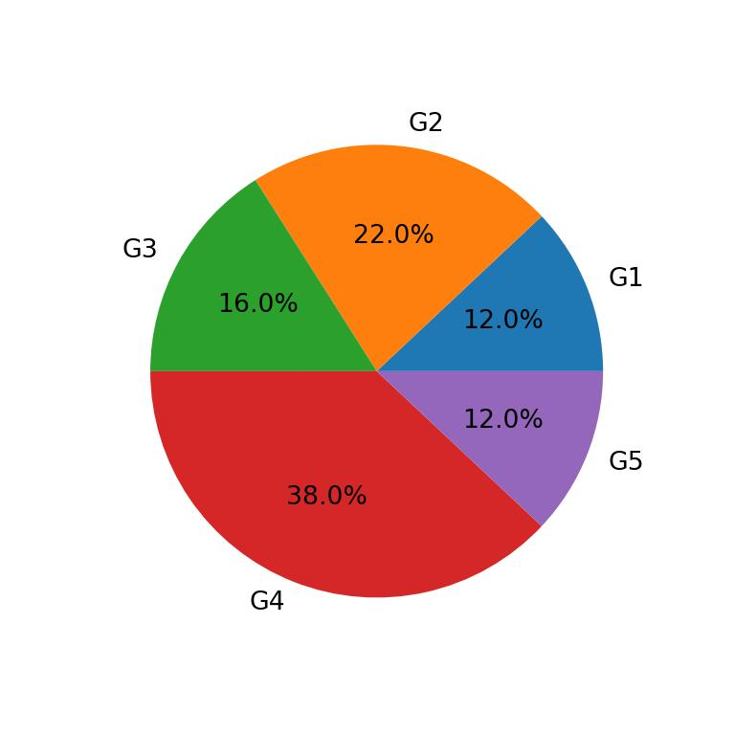
GRAPHICAL CREATION →
Technology | Purpose
Python | Main programming language
Tkinter | Graphical user interface
NumPy | Generates numerical values
Matplotlib | Creates and displays graphs
Math | Supports mathematical calculations
3. Pie Chart
Displays the proportion of each value in a dataset.
Example: 20, 30, 40, 10.
Useful for understanding percentage distribution.
1. Line Graph
Displays a mathematical function using values of x and y.
Example: \(y=x^2\)
Useful for understanding trends and function behaviour.
2. Bar Graph
Compares different numerical values using rectangular bars.
Example: 10, 20, 30, 40, 50.
Useful for comparing quantities.

Slide 9
AGE AND BMI CALCULATOR →
AGE →
BMI →
1.Calculates age automatically.
2.Reduces manual date calculations.
3.Uses Python's built-in date functions.
4.Provides accurate completed age.
5.Calculates total days lived.
Simple and user-friendly interface.
1.Easy-to-use interface.
2.Quick and accurate mathematical calculation.
3.Automatically identifies the BMI category.
4.Reduces manual calculation.
5.Provides immediate results.
6.Includes input validation to prevent zero or negative values.
datetime.strptime() – Converts the entered date into a date format.
date.today() – Retrieves the current date.
dob_entry.get() – Retrieves the date of birth entered by the user.
calculate_age() – Calculates the user's age.
if condition – Checks whether the birthday has occurred in the current year.
timedelta calculation – The difference between two dates is used to calculate total days.
age_result.config() – Displays the calculated age and total days lived.
messagebox.showerror() – Displays error messages for invalid dates.
float() – Converts the entered height and weight into numeric values.
height_entry.get() – Retrieves the height entered by the user.
weight_entry.get() – Retrieves the weight entered by the user.
calculate_bmi() – Calculates the BMI value.
if-elif-else – Determines the BMI category.
bmi_result.config() – Displays the calculated BMI and category.
messagebox.showerror() – Displays an error message for invalid inputs.

Slide 10
CHALLENGES FACED →
Handling Mathematical Expressions
Implementing Scientific Calculations
Designing a User-Friendly Interface
Performing Statistical Analysis
Solving Mathematical Equations
Creating Graphical Representations
Developing BMI and Age Calculators
Handling Errors and Invalid Inputs
Integrating Multiple Features

Slide 11
THANK YOU

